Slide 1
Literary Analysis
I can write a literary analysis that uses properly cited textual evidence.

Slide 2
What is a Literary Analysis?
Literary analysis involves breaking a piece of literature into parts and then explaining how those parts contribute to the overall or significant meaning of the text.

Slide 3
Breaking Down the Text
We break literature down in two ways:
Rhetoric (Use of Language)
Story (Plot and Fiction Elements)

Slide 4
Rhetoric
Rhetoric is the art of using words to persuade or inform. Writers use literary devices when employing rhetoric.
Literary Devices:
Details
Word Choice (Diction)
Figurative Language (Metaphors, Symbols, Analogies…)
Imagery
Structure (Syntax)

Slide 5
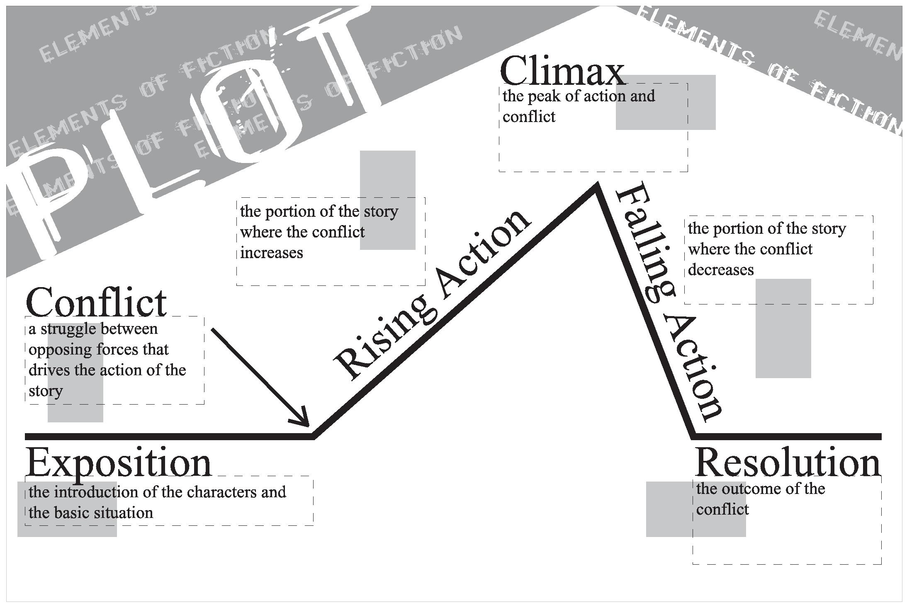
Story/Elements of Fiction
Stories are central to any meaningful literature. Some basic elements of story can be used to breakdown a story into parts.
Elements of Fiction:
Setting
Plot
Character
Conflict
Themes
Point of View

Slide 6
Significance & Meaning
Once you’ve broken down the text into a part/parts, you have to explain why it is significant or meaningful .
Significance: Something is significant if it is unique, influential, vivid, and/or relatable.
Meaning: Meaning is always related to emotions. Something is meaningful if it has a strong connection to a feeling.

Slide 7
Put it all together
Your literary analysis paragraphs should include answers to all of these questions:
1) What is meaningful about the text?
2) What is a significant part of the text?
3) How does that part of the text connect to the meaning of the text?

Slide 8
Example
In chapter one of Pirsig’s novel, Zen and the Art of Motorcycle Maintenance, readers are challenged to think deeply about what it means to be fully present. He begins this discussion by stating, “You see things vacationing on a motorcycle in a way that is completely different from any other” (4). He goes on to argue that when one rides a motorcycle, they are in the action, rather than being a “passive observer” (4). Meaning, it is better to experience through our senses, rather than only our imaginations. This concept is also significant later in the novel when…. This is a meaningful concept that Pirsig wants his readers to apply to their own lives...

Slide 9
Structuring Your Analysis
Claim (What are you claiming about the author’s use of rhetoric, a concept, etc. What is the author doing?)
Evidence (Quote/Paraphrase)
Explanation of Evidence (How does your evidence support your claim? What is the significance of this evidence?)

Slide 10
Example
In chapter one of Pirsig’s novel, Zen and the Art of Motorcycle Maintenance, readers are challenged to think deeply about what it means to be fully present. He begins this discussion by stating, “You see things vacationing on a motorcycle in a way that is completely different from any other” (4). He goes on to argue that when one rides a motorcycle, they are in the action, rather than being a “passive observer” (4). Meaning, it is better to experience through our senses, rather than only our imaginations. This concept is also significant later in the novel when…. This is a meaningful concept that Pirsig wants his readers to apply to their own lives...

